Slide 1

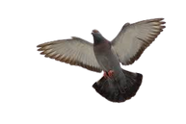




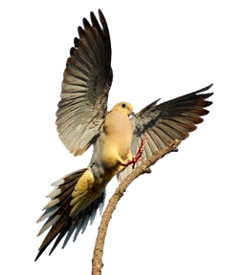
AIRPLANE BIRD STRIKES REPORT
BASH summary

Slide 2
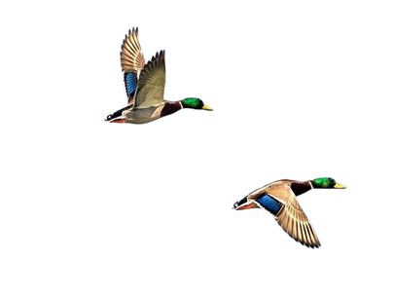



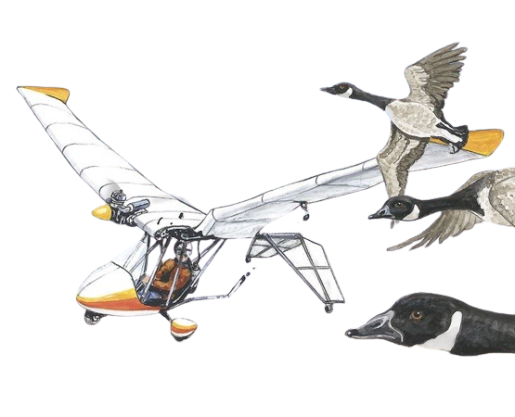
What is Bird strike
A bird strike, also known as a bird strike hazard, occurs when a bird or a flock of birds collides with an aircraft. These incidents can happen during any phase of a flight, including takeoff, landing, and cruising. Bird strikes pose a significant risk to aviation safety for several reasons:

Slide 3

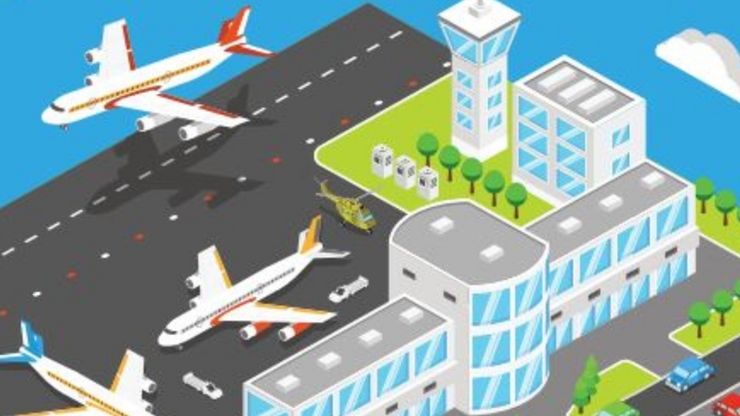
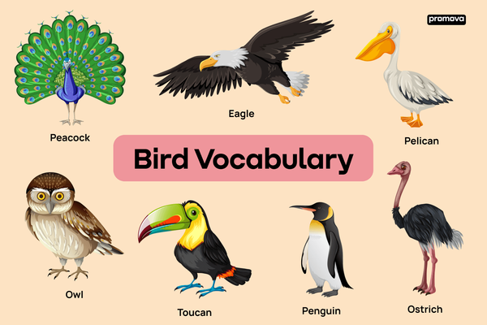


why Bird strike happen?
Bird strikes happen primarily due to the convergence of aircraft flight paths with bird flight patterns. Several factors contribute to the occurrence of bird strikes:
Proximity to Airports
Aircraft Speed
Altitude
Bird Behavior
Seasonal Factors
Environmental Conditions

Slide 4





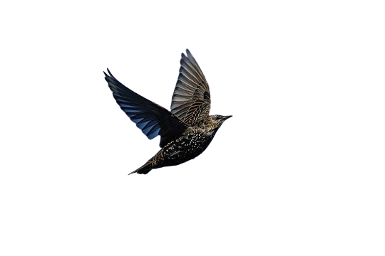
Key Aspects Related To Analysis
Total Flights Crashed
25,555
Total Repair Cost
Total Birds Involved
139 Millions
25,555

Slide 5



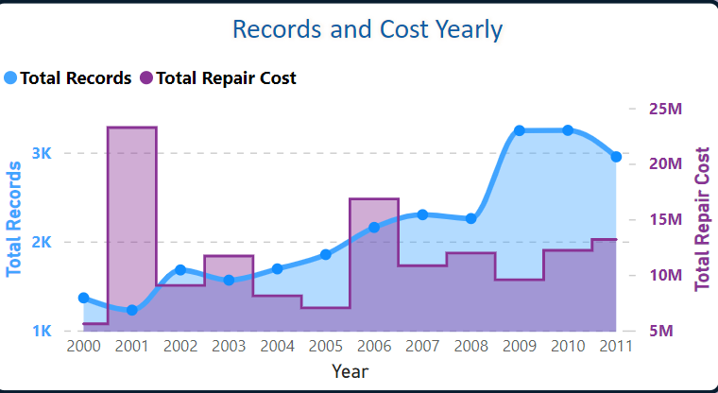
Bird Strikes By Timeline
we have a timeline for the bird strikes from 2000 to 2011

Slide 6

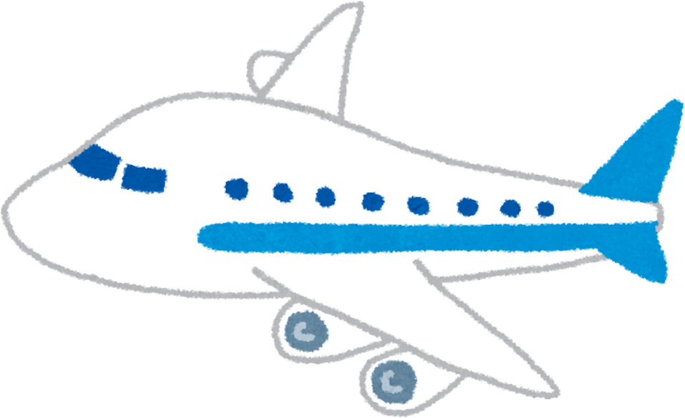
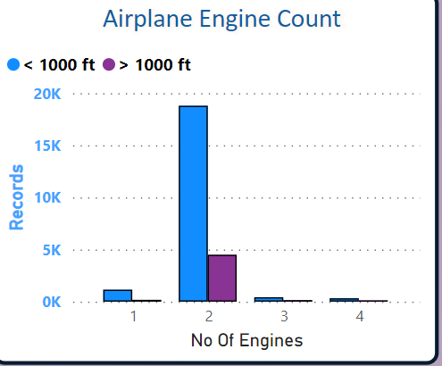
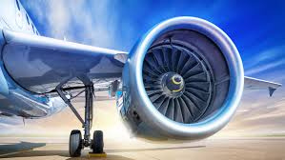
Airplane Engines By Bird Strikes

Slide 7
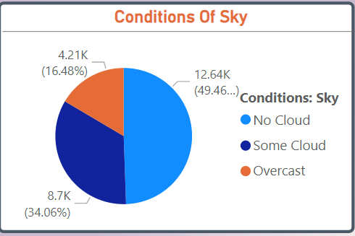
Birds Strikes At Condition Of Sky

Slide 8
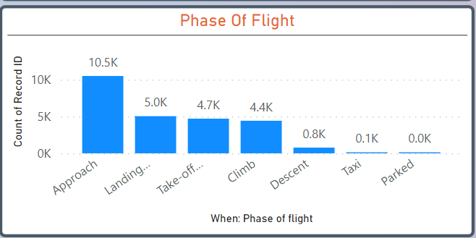
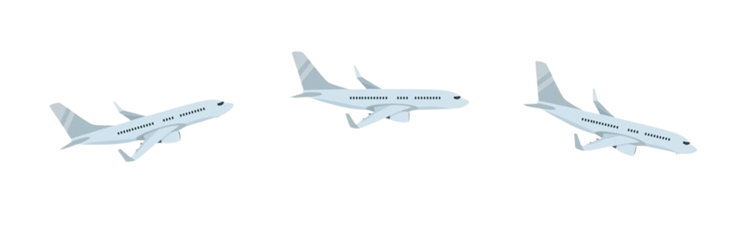
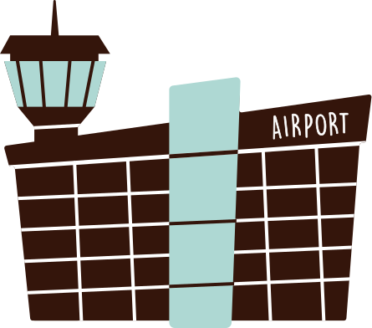

Phase Of Flight

Slide 9
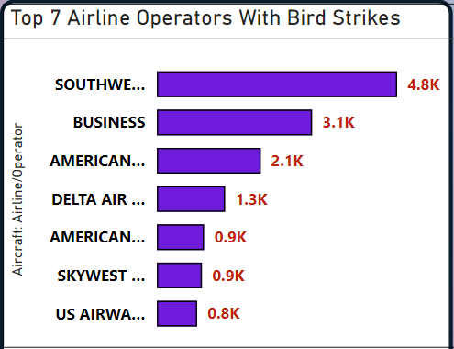
TOP 7 Airlines With Highest Bird Strikes

Slide 10
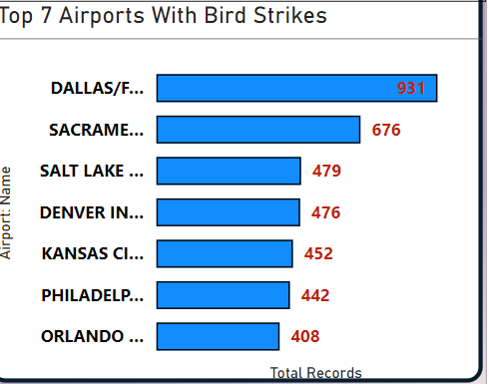




TOP 7 Airports With Highest Bird Strikes

Slide 11

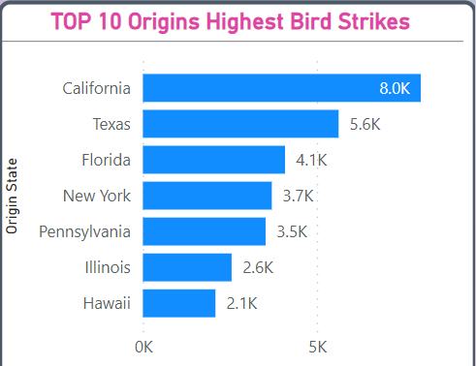
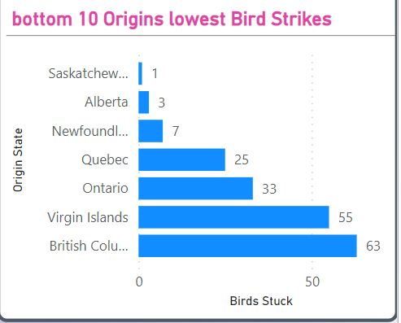
Highest & lowest Bird Strike Origins

Slide 12
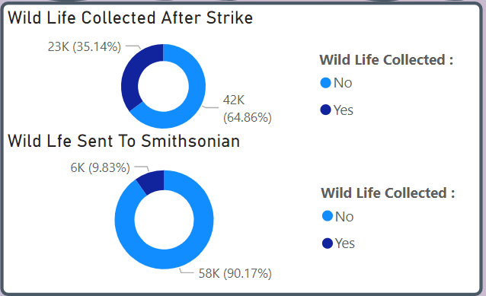
Birds Involvement

Slide 13
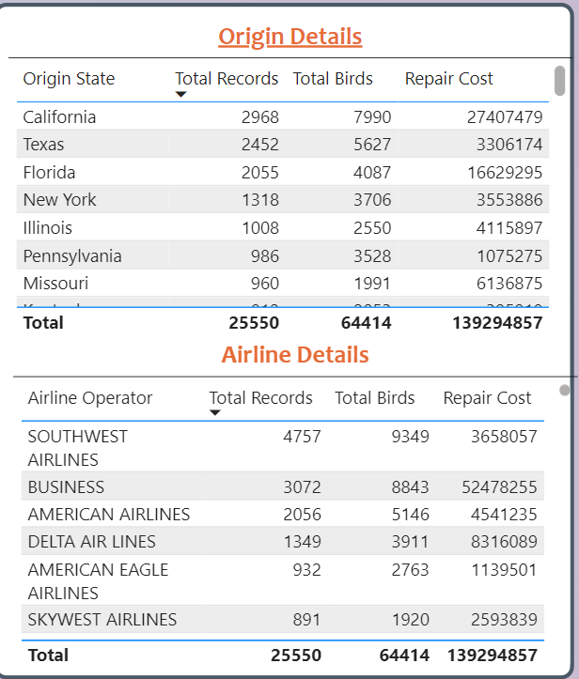
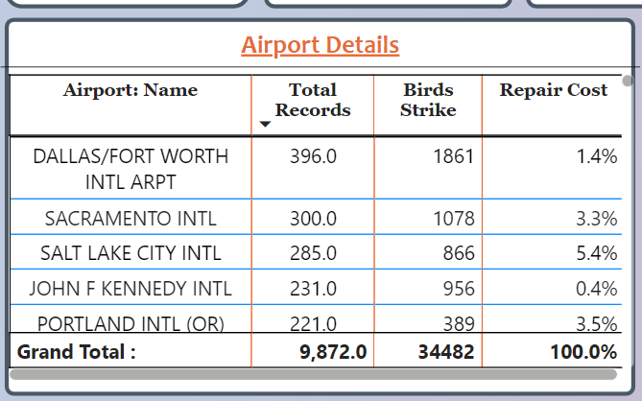
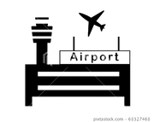

Bird Strike Details Of Airport & Origin

Slide 14
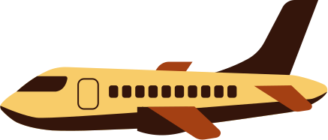
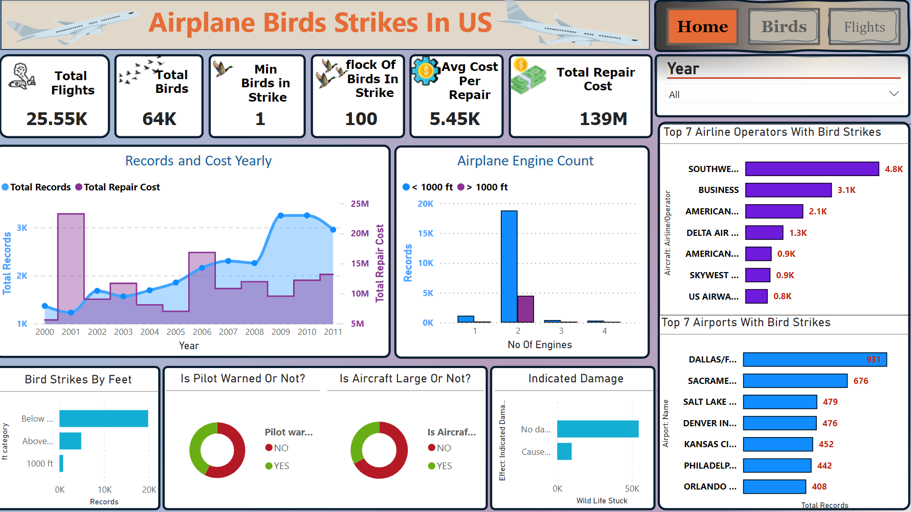
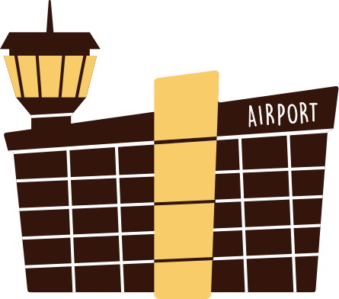

Slide 15
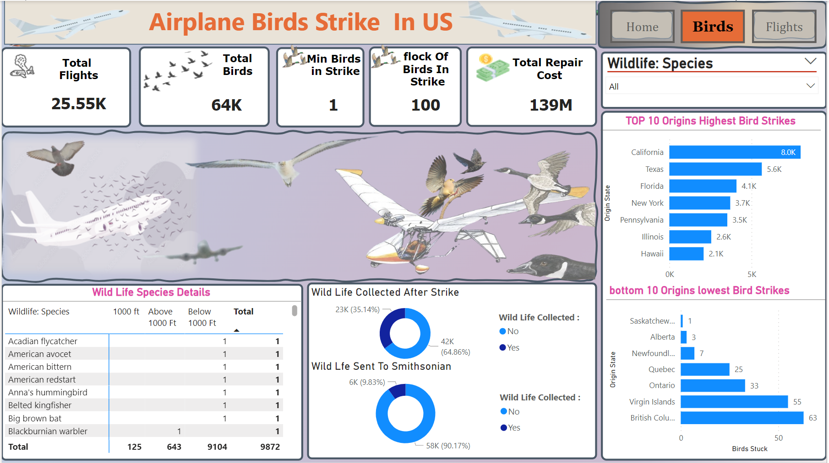

Slide 16
